Slide 1
Entity –Relationship Diagrams in DBMS: Components, Symbols, And Notations
ER model helps to systematically analyze data requirements to produce a well-designed database.
E-R diagrams are used to represent E-R model in a database, which makes them easy to be converted into relations (tables).
ERD is a diagram that displays the relationship of entity sets stored in a database.
E-R diagrams require no technical knowledge & no hardware
support.
These diagrams are very easy to understand and easy to create .
It gives a standard solution of visualizing the data logically.
E-R diagrams are created based on three basic concepts:
entities, attributes and relationships.

Slide 2
Why use ER Diagrams?
preview of how all your tables should connect, what fields are going to be on each table
ER diagrams are translatable into relational tables-database design
ER diagrams are translatable into relational tables
better understanding of the information
allows you to communicate with the logical structure of the database to users
Following are the main components and its symbols in ER Diagrams:
Rectangles: This Entity Relationship Diagram symbol represents entity types
Ellipses : Symbol represent attributes
Diamonds: This symbol represents relationship types
Lines: It links attributes to entity types and entity types with other relationship types
Primary key: attributes are underlined
Double Ellipses: Represent multi-valued attributes

Slide 3
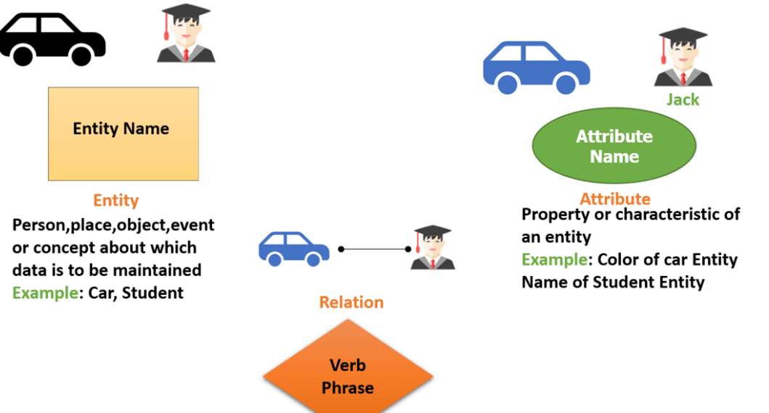
.
Components of the ER Diagram
This model is based on three basic concepts:
Entities
Attributes
Relationships

Slide 4
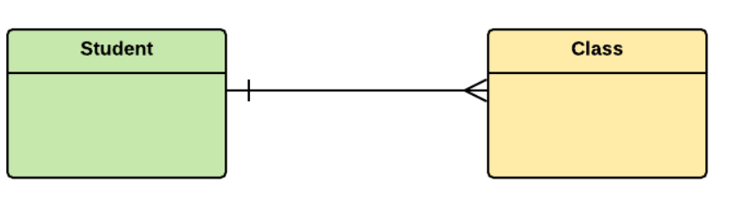
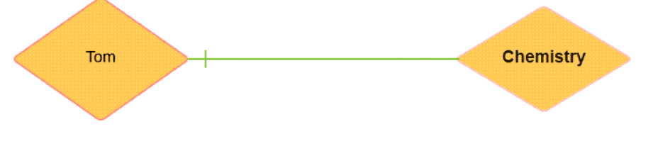
WHAT IS ENTITY?
A real-world thing either living or non-living that is easily recognizable and nonrecognizable.
An entity can be place, person, object, event or a concept, which stores data in the database. The characteristics of entities are must have an attribute, and a unique key.
Notation of an Entity
Student
For example, a student entity may have a name, age, class, as attributes.
Relationship
Relationship is nothing but an association among two or more entities. E.g., Tom works in the Chemistry department.

Slide 5
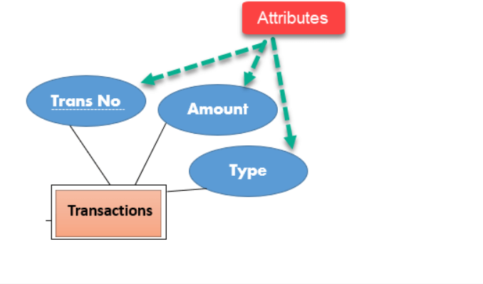
Attributes
it is a single-valued property of either an entity-type or a relationship-type.
For example, a lecture might have attributes: time, date, duration, place, etc.
An attribute in ER Diagram examples, is represented by an Ellipse

Slide 6
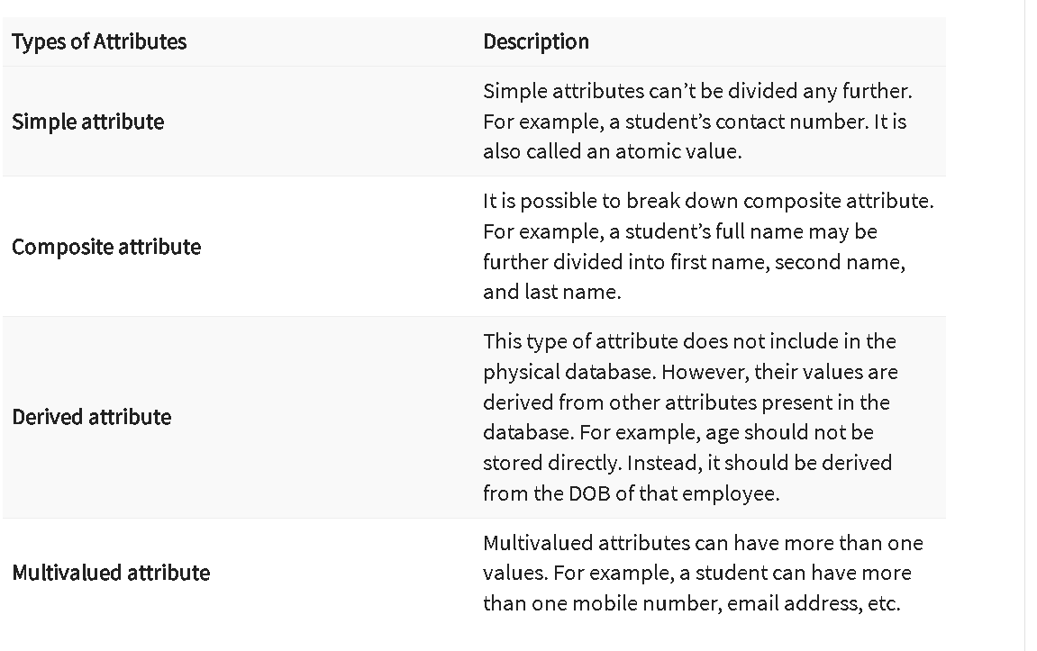

Slide 7
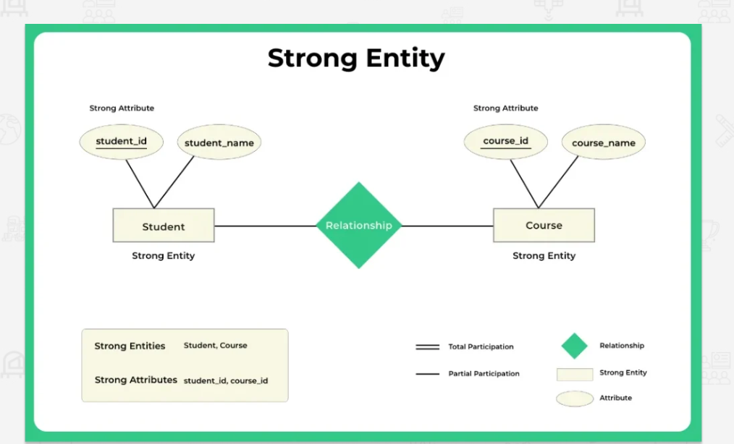
Strong entity
Strong Entity is independent of any other entity in the schema
A Strong entity is nothing but an entity set having a primary key attribute or a table that consists of a primary key column
Representation
The strong entity is represented by a single rectangle.
The relationship between two strong entities is represented by a single diamond.

Slide 8
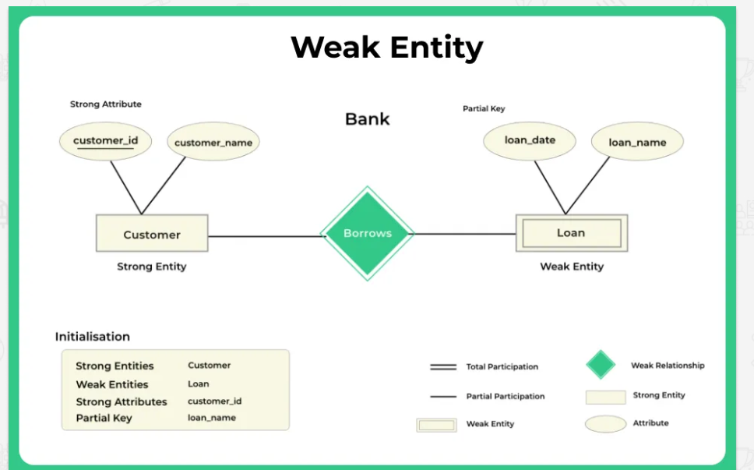
Weak entity
A weak entity is an entity set that does not have sufficient attributes for Unique Identification of its records.
Simply a weak entity is nothing but an entity that does not have a primary key attribute
Representation
A double rectangle is used for representing a weak entity set
The double diamond symbol is used for representing the relationship between a strong entity and a weak entity which is known as identifying relationship

Slide 9
